Slide 1

BLOCK CODING
In block coding, we divide our message into blocks, each of k bits, called datawords.
We add r redundant bits to each block to make the length n = k + r.
The resulting n-bit blocks are called codewords.

Slide 2

Structure of encoder and decoder in error correction

Slide 3
The Hamming distance between two words is the number of differences between corresponding bits.
The minimum Hamming distance is the smallest Hamming distance between
all possible pairs in a set of words.

Slide 4

Example 1
Let us find the Hamming distance between two pairs of words.
1. The Hamming distance d(000, 011) is 2 because
2. The Hamming distance d(10101, 11110) is 3 because

Slide 5
Example 2
Find the minimum Hamming distance of the coding scheme in Table 10.1.
Solution
We first find all Hamming distances.
The d_{min} in this case is 2.
10.

Slide 6
Example 3
Find the minimum Hamming distance of the coding scheme in Table 10.2.
Solution
We first find all the Hamming distances.
The d_{min} in this case is 3.

Slide 7
To guarantee the detection of up to s errors in all cases, the minimum
Hamming distance in a block
code must be d_{min} = s + 1.
To guarantee correction of up to t errors in all cases, the minimum Hamming distance in a block code
must be d_{min} = 2t + 1.

Slide 8
Example 4
A code scheme has a Hamming distance d_{min} = 4. What is the error detection and correction capability of this scheme?
Solution
This code guarantees the detection of up to three errors
(s = 3), but it can correct up to one error. In other words,
if this code is used for error correction, part of its capability is wasted. Error correction codes need to have an odd minimum distance (3, 5, 7, . . . ).

Slide 9
LINEAR BLOCK CODES
Almost all block codes used today belong to a subset called linear block codes. A linear block code is a code in which the exclusive OR (addition modulo-2) of two valid codewords creates another valid codeword.
In a linear block code, the exclusive OR (XOR) of any two valid codewords creates another valid codeword.

Slide 10
Hamming Codes
Hamming codes are a class of linear block codes represented by (n,k)
Where n is the codeword length of which k are data bits and r are check bits.
Let m = r, then we have: n = 2^{m} -1and k = n-m
Hamming code error detection and correction : Pl refer Lab Expt. :4 “ Background Theory Part”

Slide 11

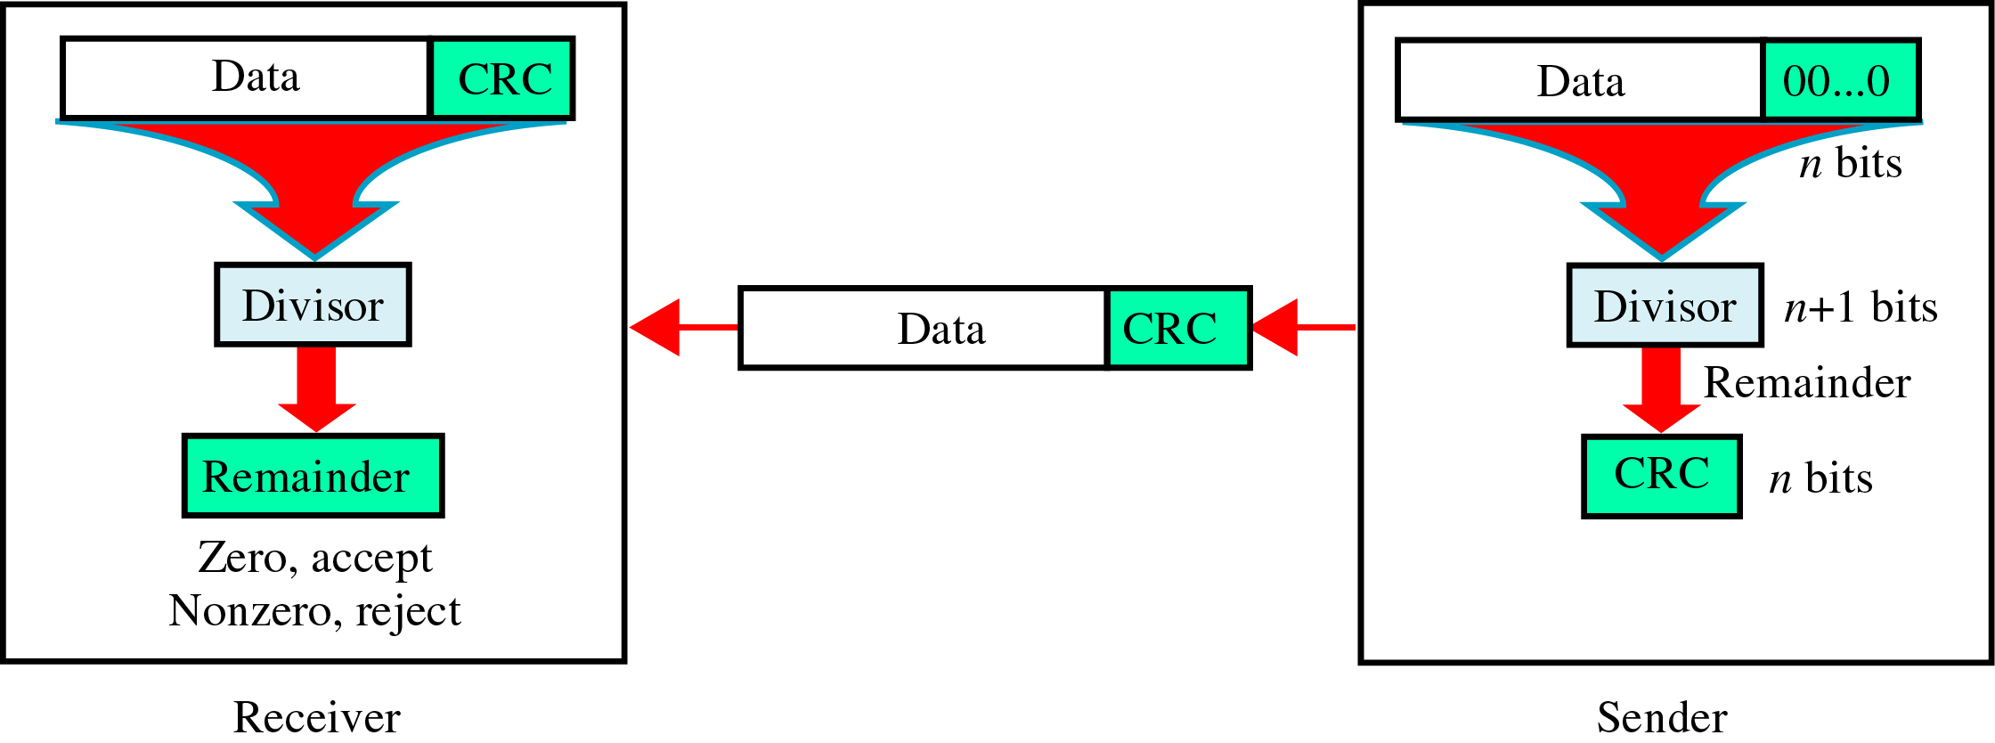
Cyclic Redundancy Check (CRC)
Based on Binary Division

Slide 12

CRC generator
Uses Modulo-2 Division

Slide 13

CRC Checker
Uses Modulo-2 Division

Slide 14

Polynomial representation of a binary word
We can use a polynomial to represent a binary word.
Each bit from right to left is mapped onto a power term.
The rightmost bit represents the “0” power term.
The bit next to it the “1” power term, etc.
If the bit is of value zero, the power term is deleted from the expression.

Slide 15
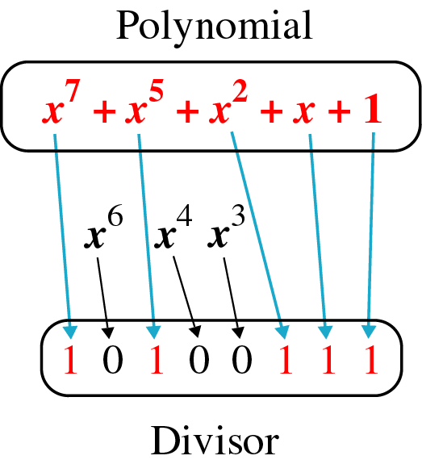
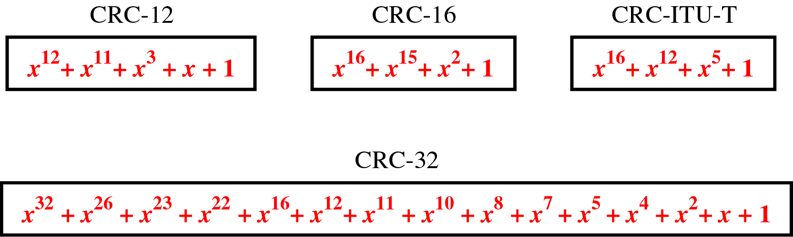
CRC generator(divisor) is most often represented not as a string of 1s and 0s, but as an algebraic polynomial

Slide 16
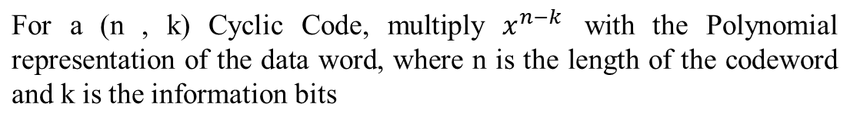

CRC division using polynomials

Slide 17
Checksum: Used by Higher layer protocols
Sender site:
The message is divided into 16-bit words.
The value of the checksum word is set to 0.
All words including the checksum are added using one’s complement addition.
The sum is complemented and becomes the checksum.
The checksum is sent with the data.
Receiver site:
The message (including checksum) is divided into 16-bit words.
All words are added using one’s complement addition.
The sum is complemented and becomes the new checksum.
If the value of checksum is 0, the message is accepted; otherwise, it is rejected.

Slide 18
Example 5
Suppose our data is a list of five 4-bit numbers that we want to send to a destination. In addition to sending these numbers, we send the sum of the numbers. For example, if the set of numbers is (7, 11, 12, 0, 6), we send (7, 11, 12, 0, 6, 36), where 36 is the sum of the original numbers. The receiver adds the five numbers and compares the result with the sum. If the two are the same, the receiver assumes no error, accepts the five numbers, and discards the sum. Otherwise, there is an error somewhere and the data are not accepted.

Slide 19
Example 6
We can make the job of the receiver easier if we send the negative (complement) of the sum, called the checksum. In this case, we send (7, 11, 12, 0, 6, −36). The receiver can add all the numbers received (including the checksum). If the result is 0, it assumes no error; otherwise, there is an error.

Slide 20
Example 7
How can we represent the number 21 in one’s complement arithmetic using only four bits?
Solution
The number 21 in binary is 10101 (it needs five bits). We can wrap the leftmost bit and add it to the four rightmost bits. We have (0101 + 1) = 0110 or 6.

Slide 21
Example 8
How can we represent the number −6 in one’s complement arithmetic using only four bits?
Solution
In one’s complement arithmetic, the negative or complement of a number is found by inverting all bits. Positive 6 is 0110; negative 6 is 1001. If we consider only unsigned numbers, this is 9. In other words, the complement of 6 is 9. Another way to find the complement of a number in one’s complement arithmetic is to subtract the number from 2^{n} − 1 (16 − 1 in this case).

Slide 22
Example 9
Let us redo Exercise 10.19 using one’s complement arithmetic. Figure 10.24 shows the process at the sender and at the receiver. The sender initializes the checksum to 0 and adds all data items and the checksum (the checksum is considered as one data item and is shown in color). The result is 36. However, 36 cannot be expressed in 4 bits. The extra two bits are wrapped and added with the sum to create the wrapped sum value 6. In the figure, we have shown the details in binary. The sum is then complemented, resulting in the checksum value 9 (15 − 6 = 9). The sender now sends six data items to the receiver including the checksum 9.
10.

Slide 23
Example 9 (continued)
The receiver follows the same procedure as the sender. It adds all data items (including the checksum); the result is 45. The sum is wrapped and becomes 15. The wrapped sum is complemented and becomes 0. Since the value of the checksum is 0, this means that the data is not corrupted. The receiver drops the checksum and keeps the other data items. If the checksum is not zero, the entire packet is dropped.

Slide 24
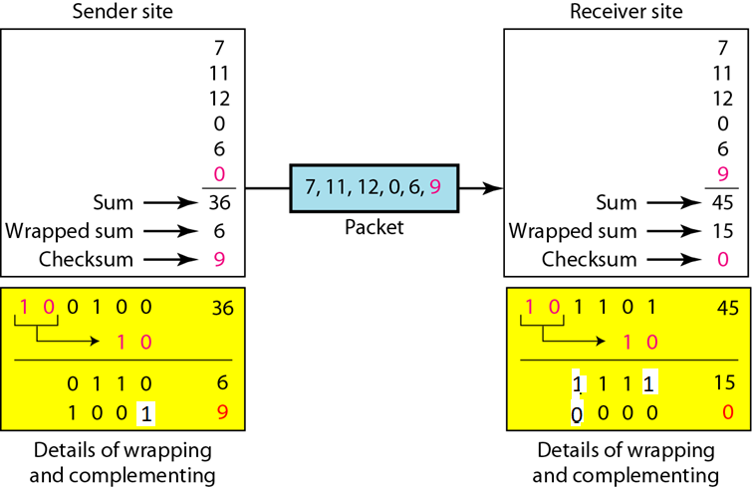
Example 9

Slide 25
Example 10
Let us calculate the checksum for a text of 8 characters (“Forouzan”). The text needs to be divided into 2-byte (16-bit) words. We use ASCII (see Appendix A) to change each byte to a 2-digit hexadecimal number. For example, F is represented as 0x46 and o is represented as 0x6F. Figure 10.25 shows how the checksum is calculated at the sender and receiver sites. In part a of the figure, the value of partial sum for the first column is 0x36. We keep the rightmost digit (6) and insert the leftmost digit (3) as the carry in the second column. The process is repeated for each column. Note that if there is any corruption, the checksum recalculated by the receiver is not all 0s. We leave this an exercise.

Slide 26

Example 10

